Slide 1
Fill the Fridge PSA Campaign Toolkit
Included in this document you will find:
A radio script template
Images and copy for social media posts

Slide 2
What’s Fill the Fridge?
“Fill the Fridge” is the theme Second Harvest Heartland is using this fall and winter to encourage those facing food insecurity to seek out the resources in their communities.
It’s also language that encourages those who are able to help fill their neighbor's fridges through donations, volunteering and more.
These resources are for you to customize and use as you find it helpful.

Slide 3
Radio Script PSA
This radio script template should be customized with your town name and website, and then provided to your local radio stations with request to read it on air this season. It has been timed to 30 seconds.
It’s time to fill the fridge, Minnesota! More of us are facing hunger than ever before, so you need to know that hunger-fighting resources are available in every community, including right here in [town name]. We’re inviting you to fill ‘er up by visiting our local food shelves and distribution sites, by applying for SNAP, downloading the Free Meals 4 Kids app, and finding help for our seniors. Fuel your ability to fight this pandemic, and leave behind the worry, fear and hunger pangs. Learn more at [2harvest.org].

Slide 4
Social Media Content
This radio script template should be customized with your town name and website, and then provided to your local radio stations with request to read it on air this season. It has been timed to 30 seconds.

Slide 5
Facebook/Instagram Copy
These are challenging times, and everyone is going to need a little extra help. We want you to know that there are hunger-fighting resources available in every community—including right here in [town name]! Fill your fridge by visiting our local food shelves and distribution sites, by applying for SNAP, downloading the Free Meals 4 Kids app, and finding help for our seniors. Learn more at [2harvest.org].
Need food for you and your family? [Partner name], alongside many community partners and programs, is here and ready to help fuel you, your family and our community through COVID-19. Learn about the food resources available in your area at [2harvest.org].
It’s time to fill the fridge, Minnesota! More of us are facing hunger than ever before, so we want you to know that hunger-fighting resources are available in every community, including right here in [town name]! Learn about all of the food resources available at [2harvest.org].

Slide 6
Twitter Copy
These are challenging times, and everyone is going to need a little extra help. We want you to know that there are hunger-fighting resources available right here in [town name]! Learn how to fill your fridge at [2harvest.org].
Need food for you and your family? [Partner name], alongside many community partners and programs, is here and ready to help fuel you, your family and our community through COVID-19. Learn about the food resources available in your area at [2harvest.org].
It’s time to fill the fridge, MN! More of us are facing hunger than ever before, so we want you to know that hunger-fighting resources are available in every community, including right here in [town name]! Learn about food resources available at [2harvest.org].

Slide 7
Social Media Images
The following four slides contain JPG images that can be saved out of this slide deck and posted to social media.
But first, to customize to your organization, remove the grey box and ‘your logo here’ from the bottom right of each image and insert your logo, preferably as a PNG file with no background.
The individual slides can then be saved as JPGs for posting on social media.

Slide 8
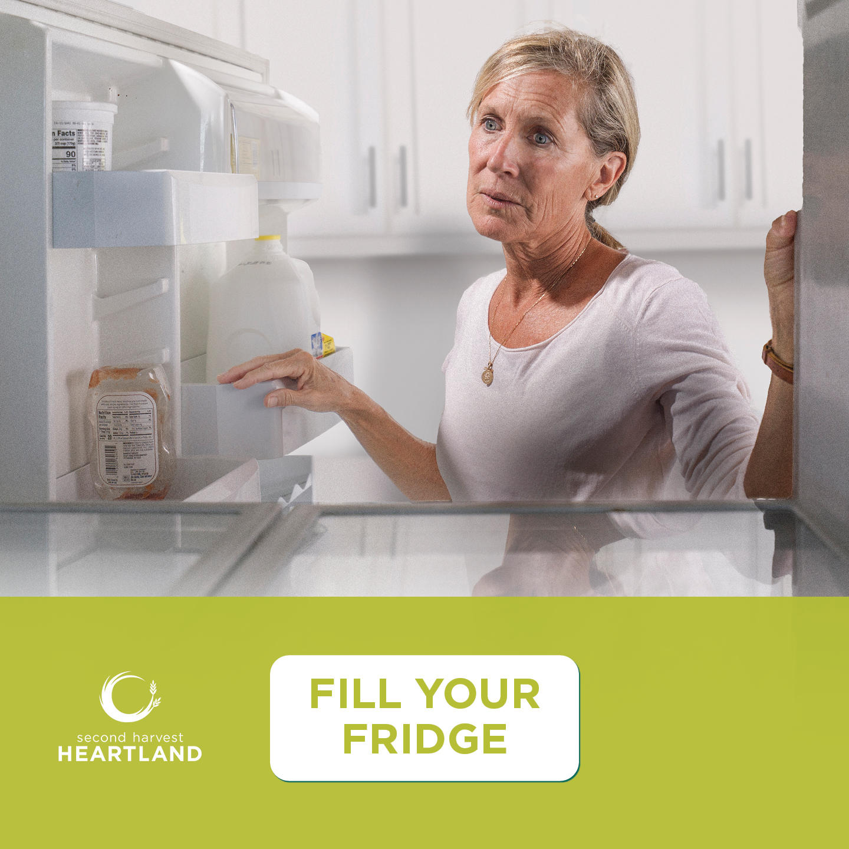
YOUR LOGO HERE

Slide 9
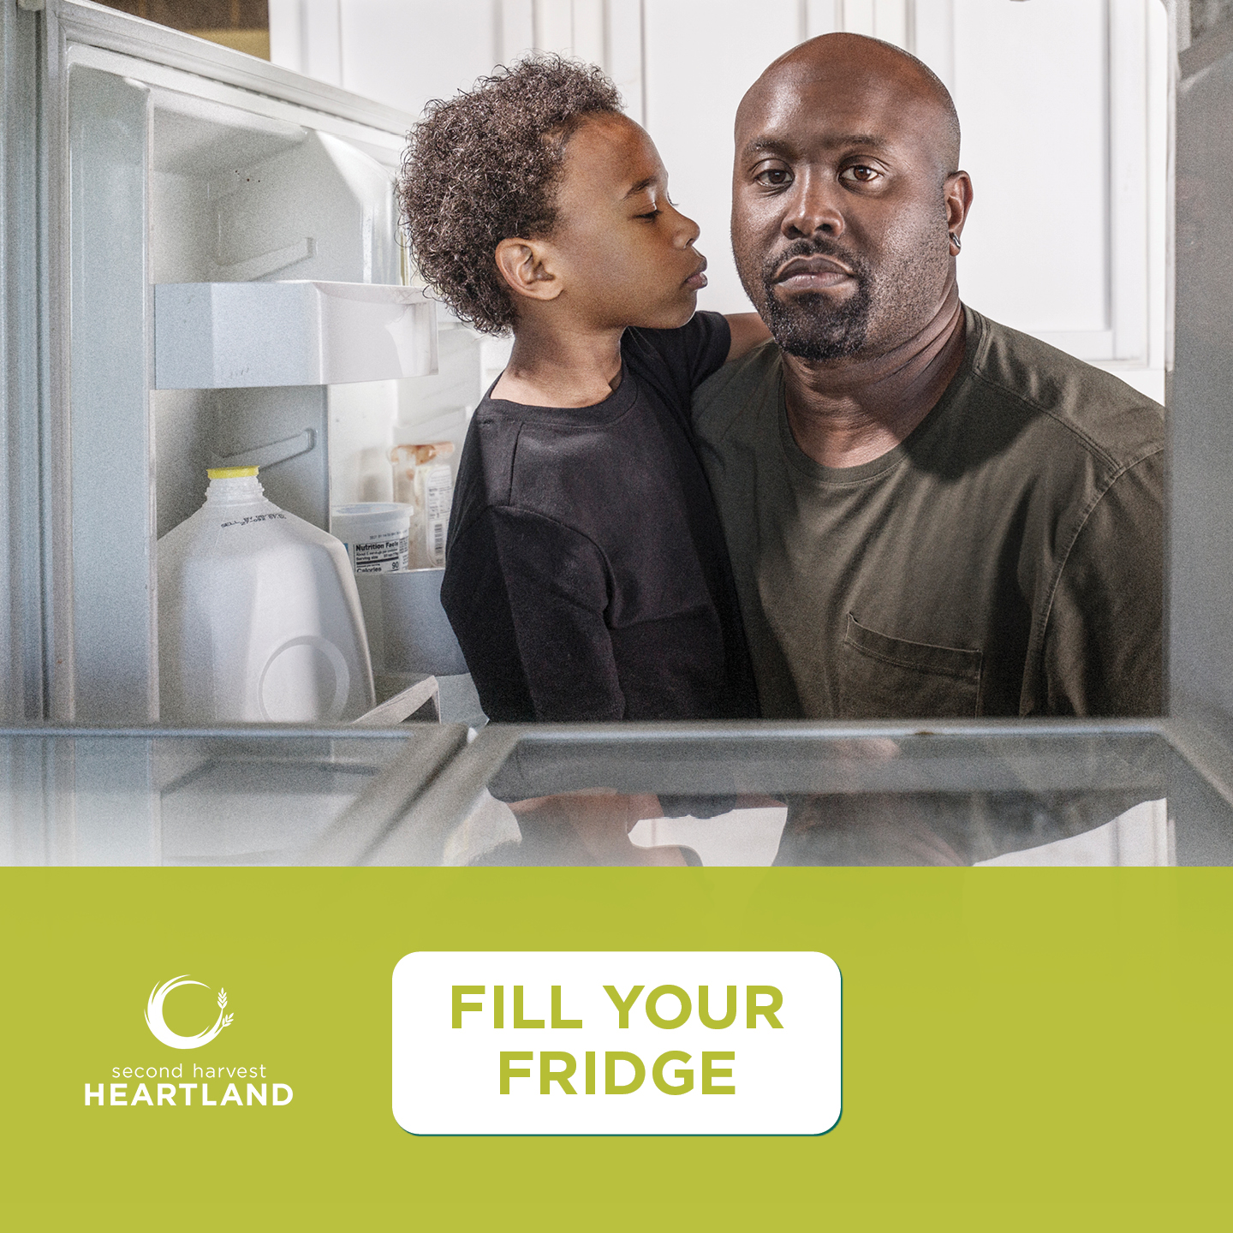
YOUR LOGO HERE

Slide 10
YOUR LOGO HERE

Slide 11
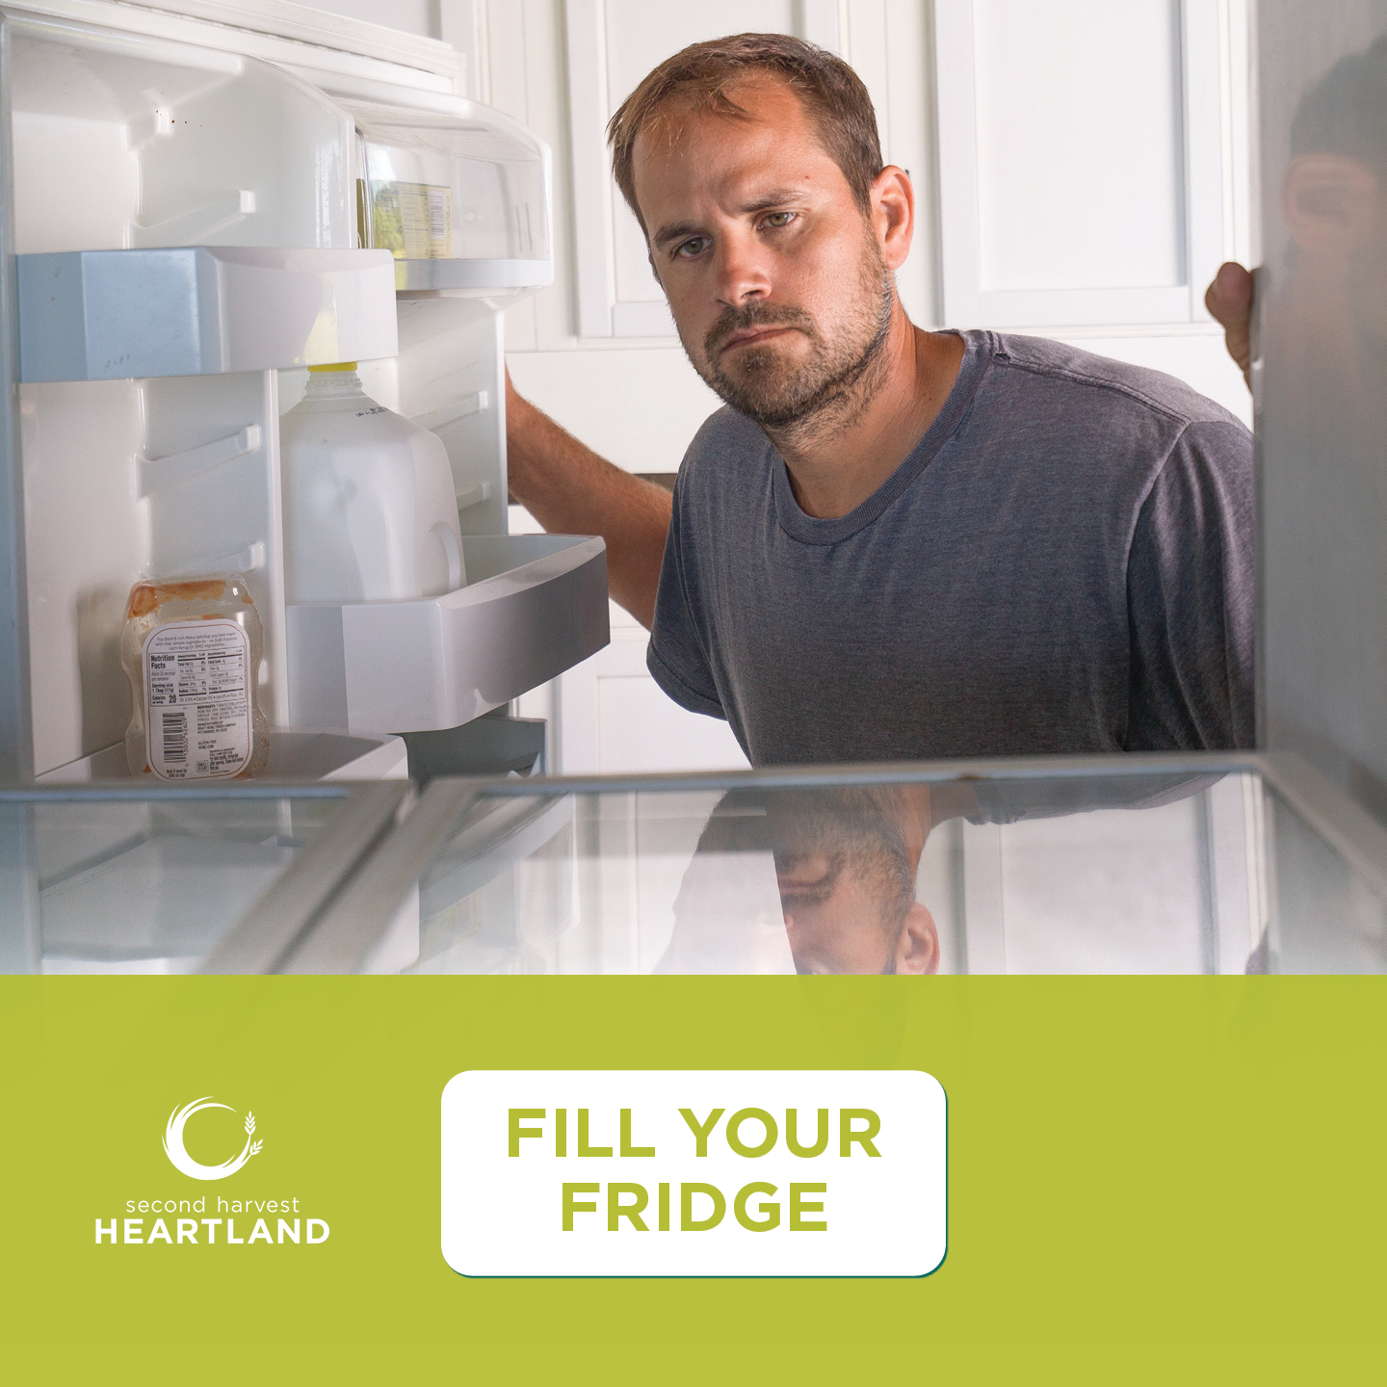
YOUR LOGO HERE

